Slide 1
Weekly report: Team Project Development
Week number: 07
Date: 01/12/2025
Supervisor: Dr. Marina Blohm
Group members: Luis Urhahn, Ahmed Sallam, Ceren Cetin, Sohail Mansuri
Presenter: Luis Urhahn

Slide 2
Tasks of the week
Overall task:
→ Developing the simulation in WindPro and getting the results for the AEP.
Week 7: Update Wind Resource Data, MCP + ResGen,
Week 8: Calculate the first AEP calculation, develop a first WF Layout, Earthquake research,
Week 9: Define the Power Curve of the Optimus WTG, insert the turbine Data of Optimus, first calculation of the AEP of Optimus,
Week 10: Performing the noise and shadow calculation of the single Optimus Turbine and defining the final available Windfarm area at our location.
Luis Urhahn

Slide 3
Progress: WindPro Simulation
Update on the Wind Ressource Implementation in the WindPro model:
Implementing of the measured data from the met mast in 2006
Complex, due to special format for the input data in WindPro
Developing of a new Excel format with correct values
Lots of problems due to different format requirements in WindPro
Transferring into a CSV-file for compliance with WindPro requirement
Performing an MCP Analysis (Measure, Correlate, Predict)
Comparing the long-term data with the measured data
Checking for similarities and dissent
Inserting the ResGen Modul
For the generation of the Wind Energy Resource
Now possible with the implemented measured data (MCP)
First calculation
Luis Urhahn

Slide 4
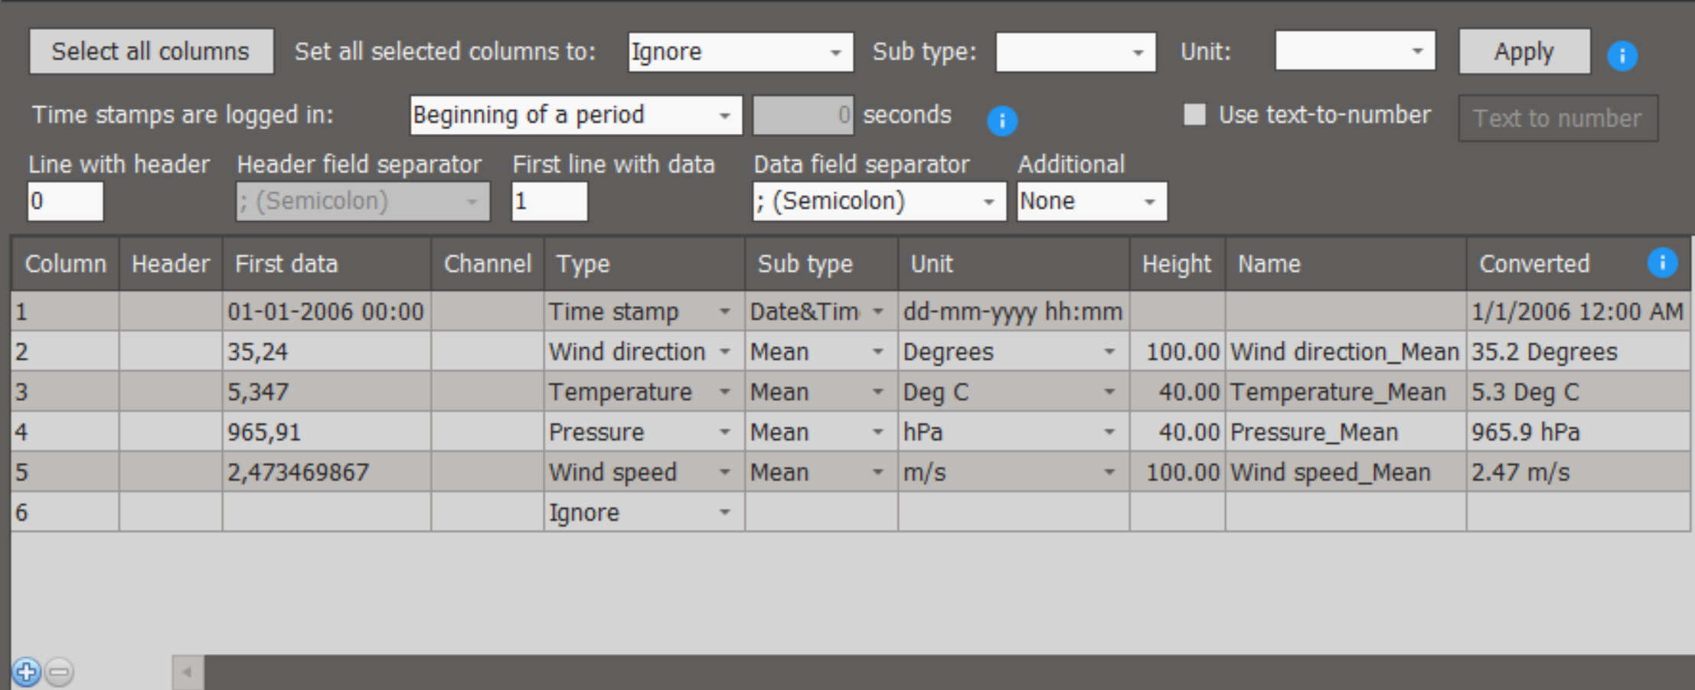
Progress: WindPro Simulation
Implementing of the measured data:
Figure 1: Screenshot of implementation of measured wind data [1]
Luis Urhahn

Slide 5
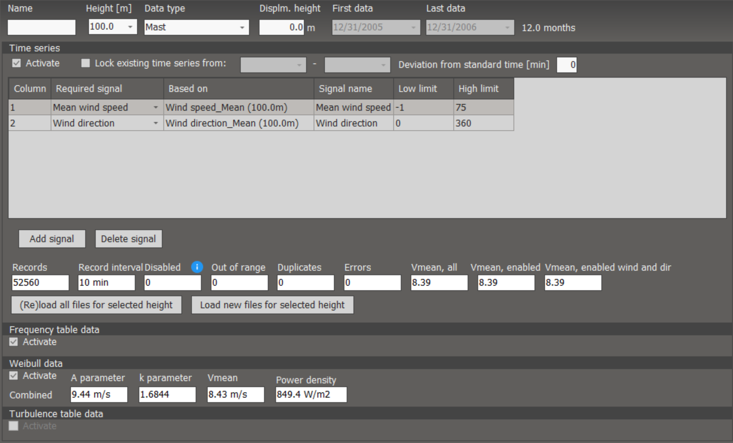
Progress: WindPro Simulation
Implementing of the measured data:
Figure 2: Screenshot of implementation of measured wind data [1]
Luis Urhahn

Slide 6
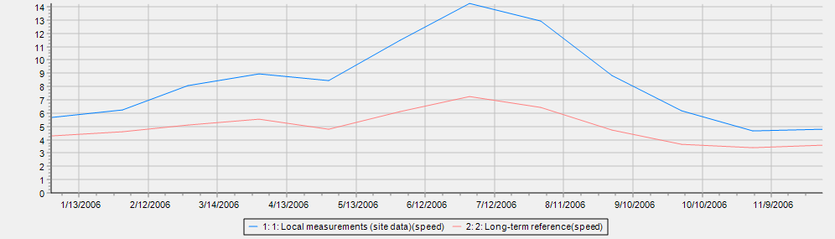
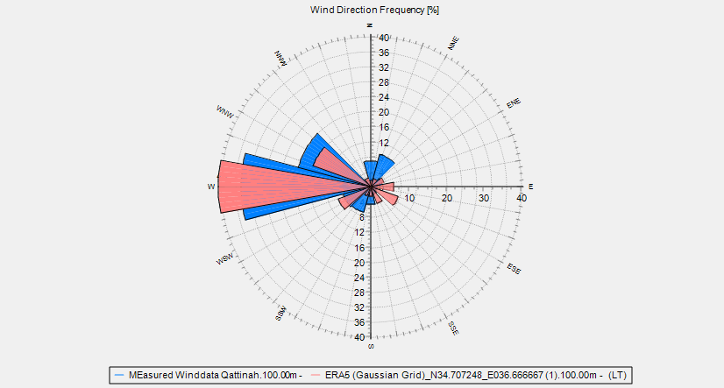
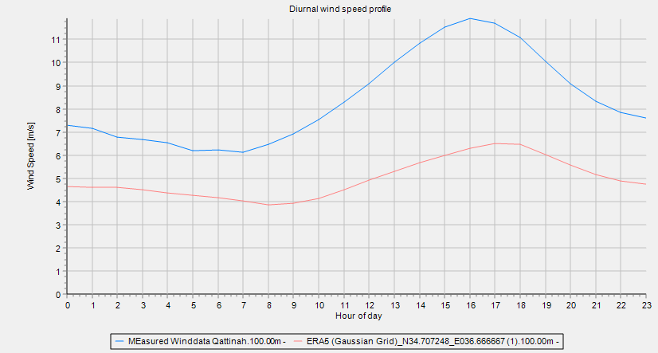
Progress: WindPro Simulation
MCP Analysis (Measure, Correlate, Predict):
Figure 4: Comparison of the wind resource data in 2006 [1]
Figure 3: Comparison of the Wind rose [1]
Figure 5: Comparison of the wind resource data in a day [1]
Luis Urhahn

Slide 7
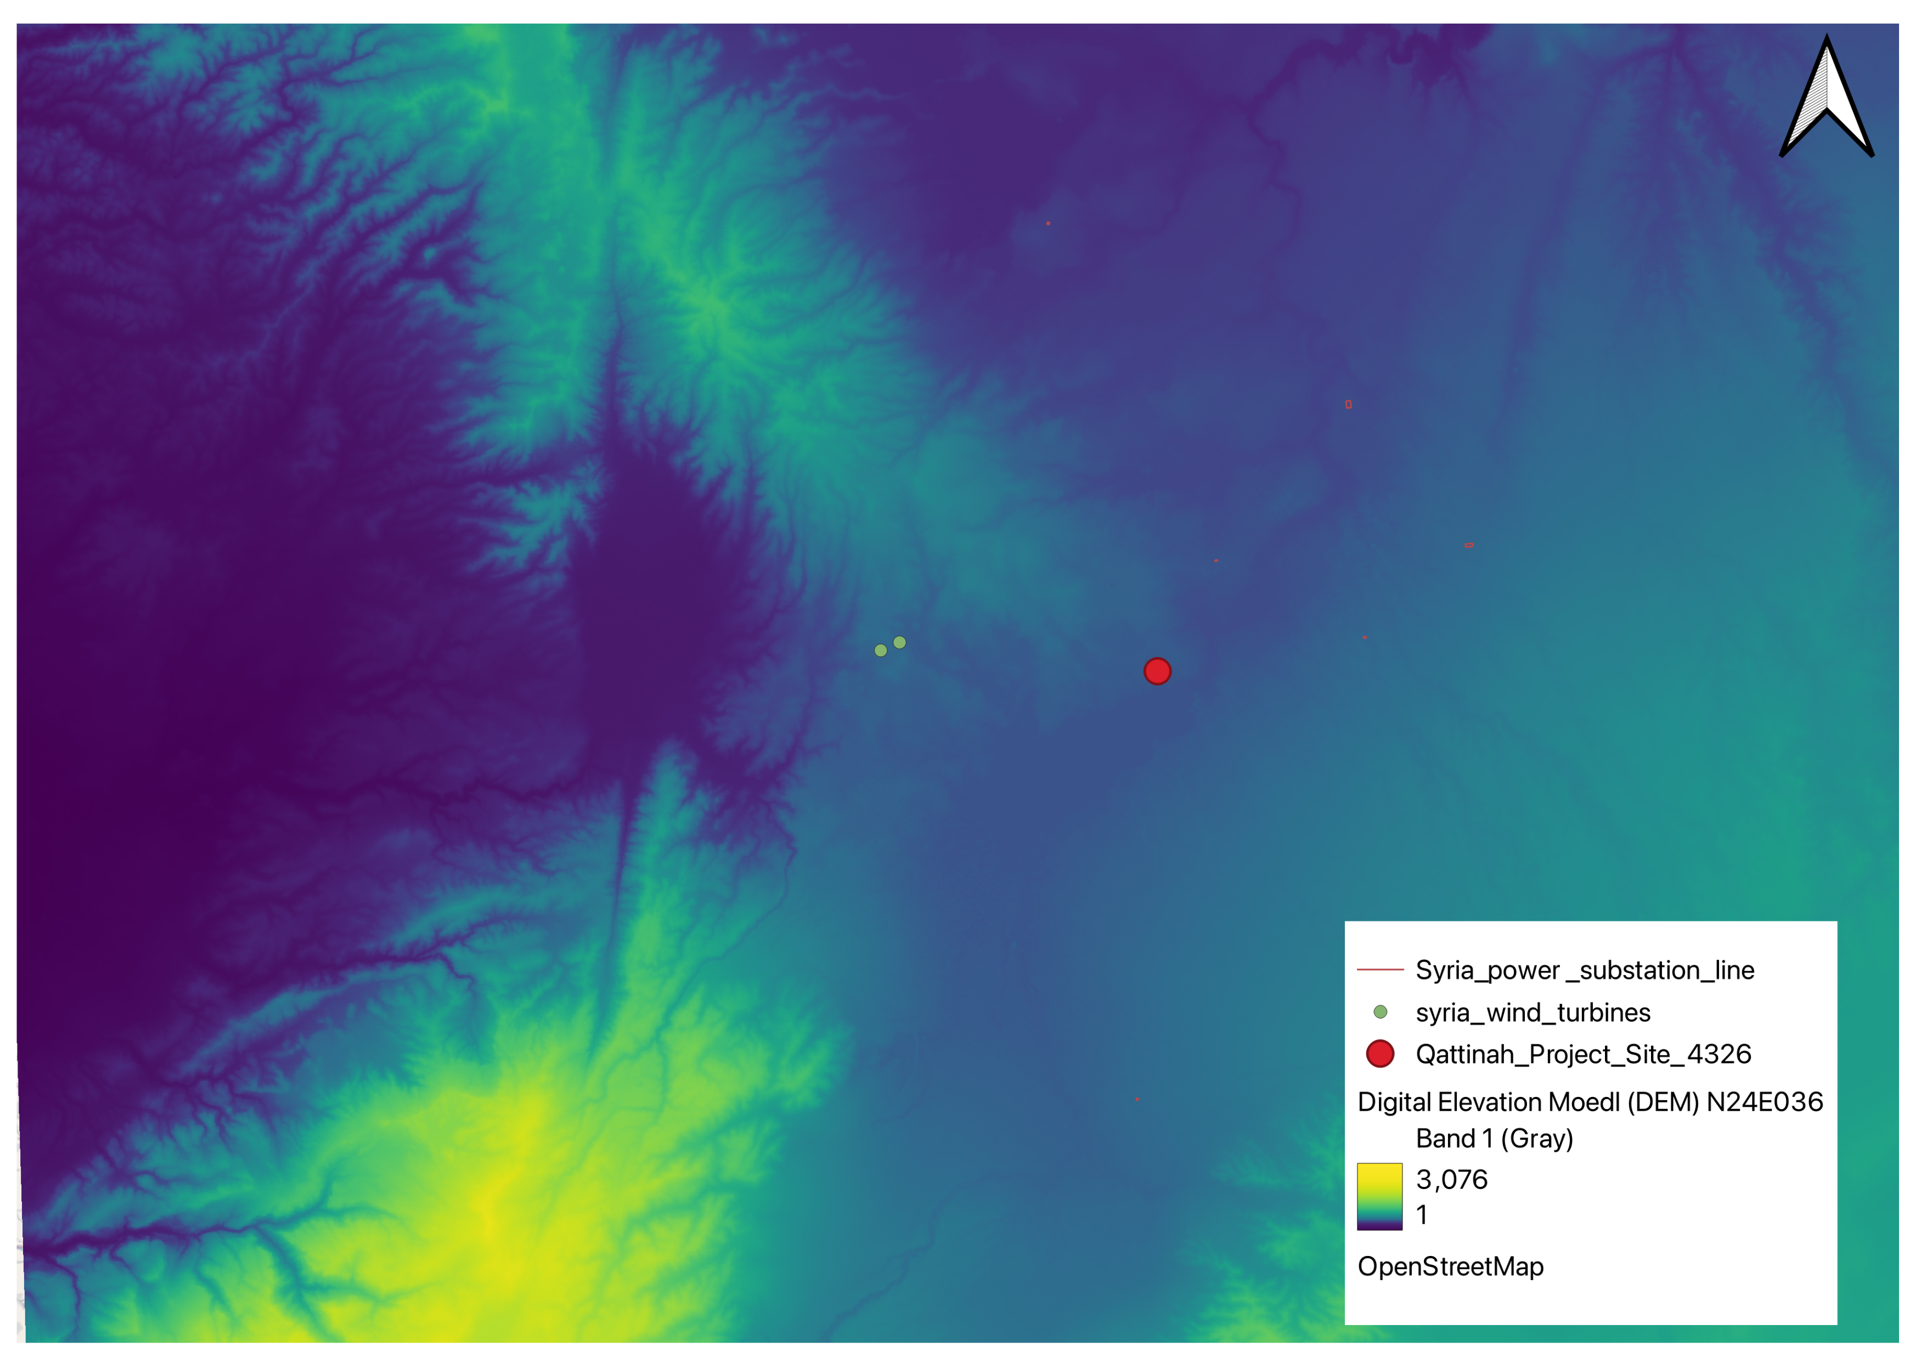
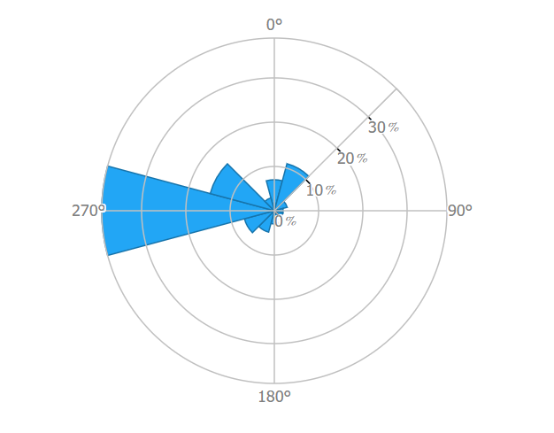
Explanation of the wind conditions
Why do we have such high wind speeds at our location?
Figure 7: Windrose of the measured data
Figure 6: Elevation Map QGIS [6]
Luis Urhahn

Slide 8
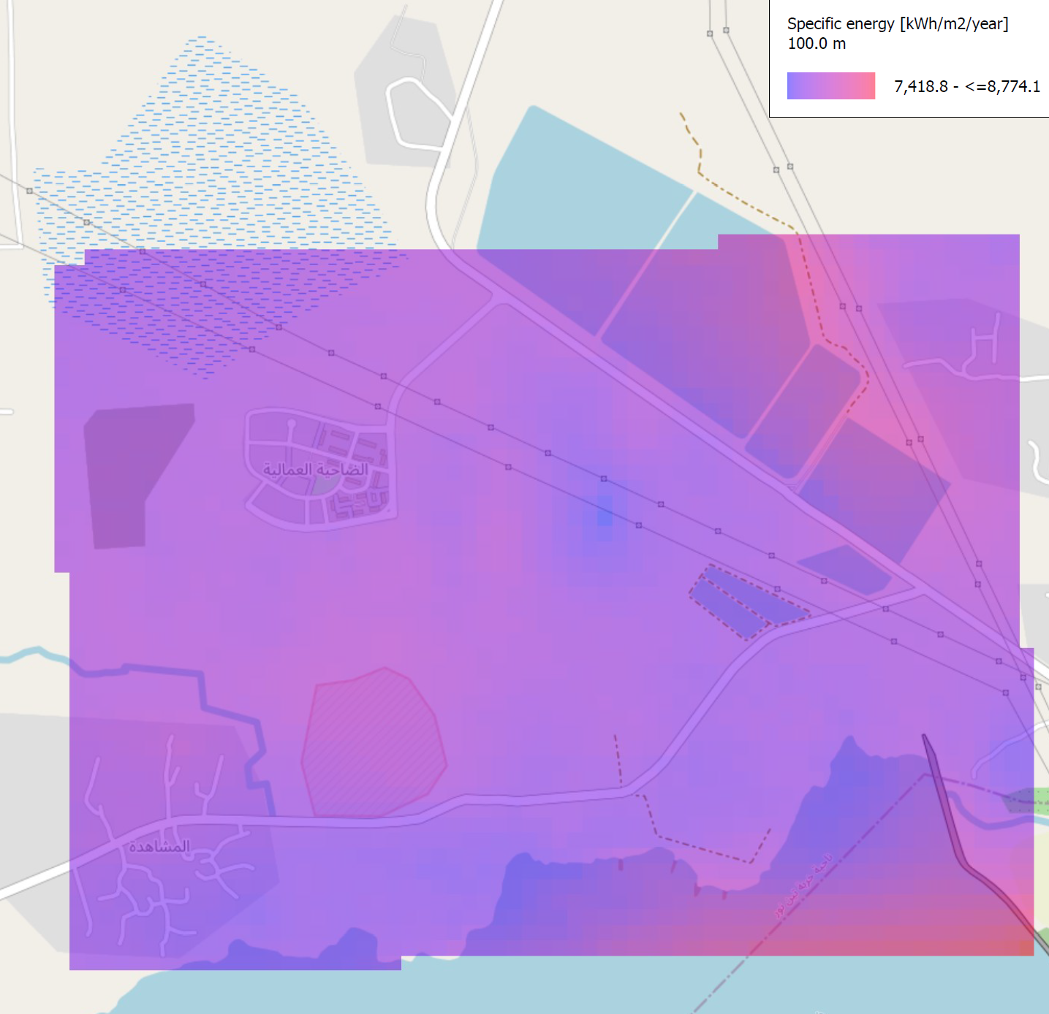
Progress: WindPro Simulation
Calculation of the Wind Resource Map:
Figure 8: Screenshot of the created Wind Resource Map [1]
Luis Urhahn

Slide 9
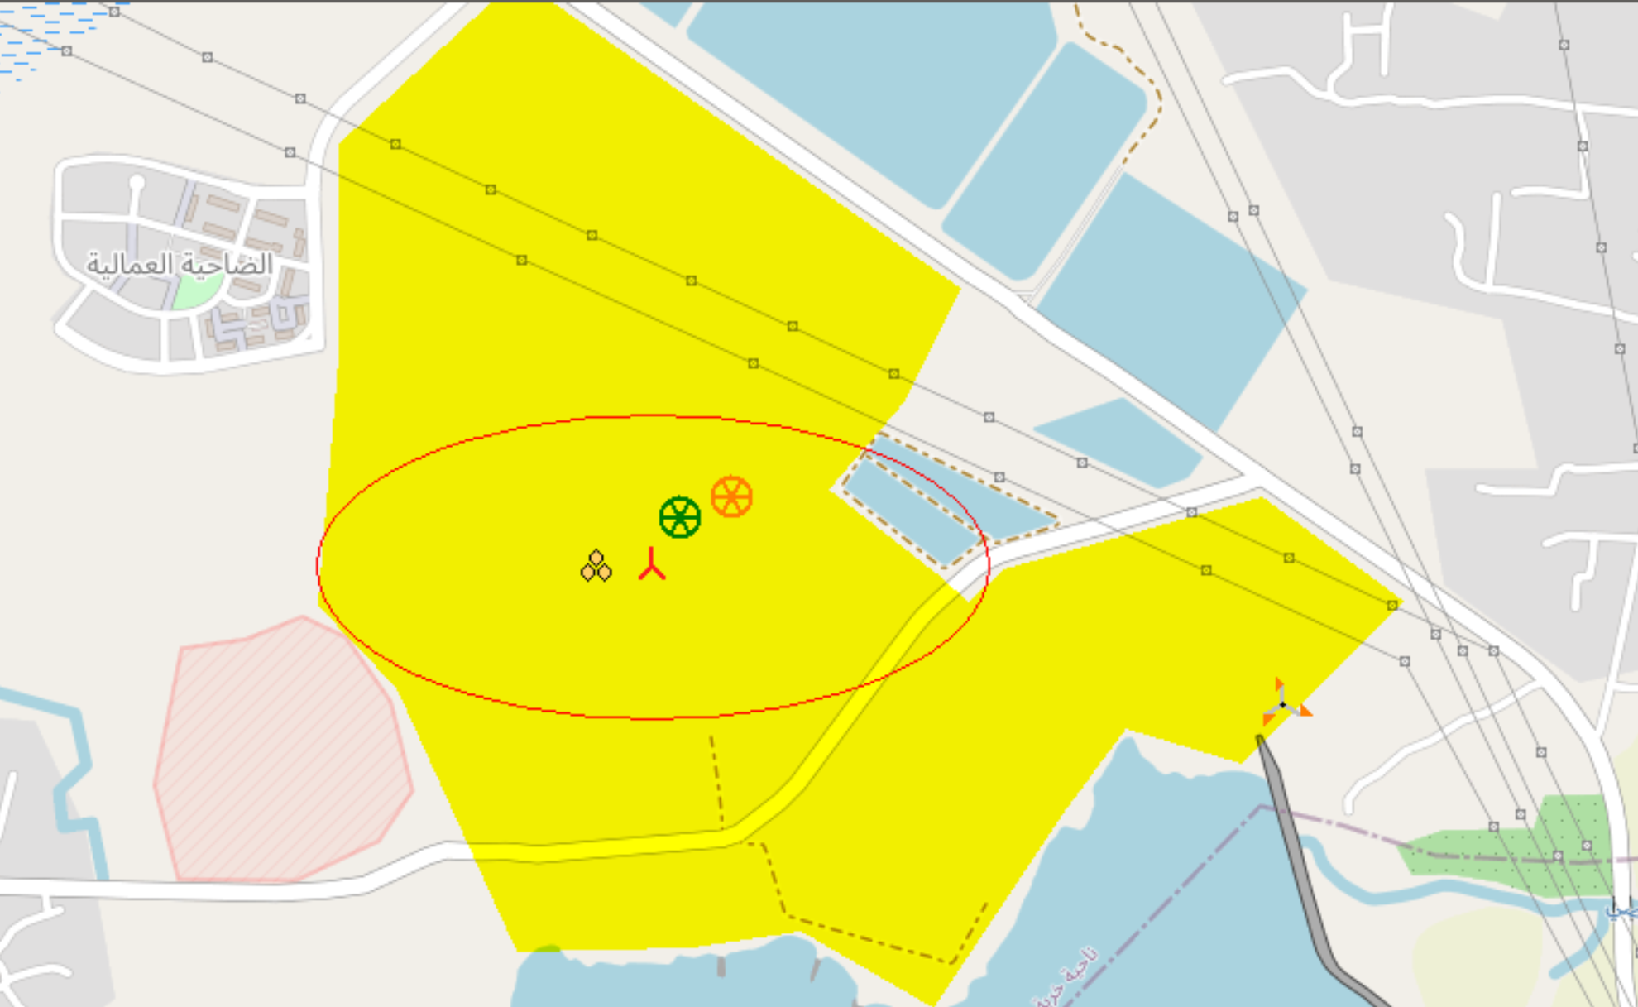
Progress: WindPro Simulation
Distance circle:
4.0 x Rotordiameter in main wind direction, (r = 640m)
1.8 x Rotordiameter perpendicular, (r = 288m)
Defines the minimum distance between the turbines
It will be difficult to find further options without significant restrictions in terms of noise or shadow.
Figure 9: Screenshot of the distance circle [1]
Luis Urhahn

Slide 10
Progress: WindPro Simulation
Power Curve Optimus Syria
Windspeed [m/s] | Power [kW] | c_p | pitch angle [°]
1 | 0 | 0 | 0
2 | 0 | 0 | 0
3 | 120,49 | 0,45 | 0
4 | 285,62 | 0,45 | 0
5 | 557,85 | 0,45 | 0
6 | 963,96 | 0,45 | 0
7 | 1.530,73 | 0,45 | 0
8 | 2.284,94 | 0,45 | 0
9 | 3.253,36 | 0,45 | 0
10 | 4.462,78 | 0,45 | 0
11 | 5.000,00 | 0,37 | 0
12 | 5.000,00 | 0,28 | 0
13 | 5.000,00 | 0,22 | 0
14 | 5.000,00 | 0,18 | 0
15 | 5.000,00 | 0,14 | 0
16 | 5.000,00 | 0,12 | 0
17 | 5.000,00 | 0,10 | 0
18 | 5.000,00 | 0,08 | 0
19 | 5.000,00 | 0,07 | 0
20 | 5.000,00 | 0,06 | 0
21 | 5.000,00 | 0,05 | 0
22 | 5.000,00 | 0,05 | 0
23 | 5.000,00 | 0,04 | 0
24 | 5.000,00 | 0,04 | 0
25 | 5.000,00 | 0,03 | 0
> 25 | 0 | 0 | 0
Calculate the Power Curve of the turbine.
Inserting the Power Curve and Turbine Data in WindPro
Calculating the AEP with the help of the “PARK-Calculation” in WindPro
Table 1: Table of the Power Curve OSY160-5.0 MW
Luis Urhahn

Slide 11
Progress: WindPro Simulation
Park Calculation for 1xOSY160-5.0 MW (MCP data):
Parameter | Unit | Value
Result Park (AEP) | MWh/year | 22 491.8
Capacity factor | % | 51.3
Full Load Hours (FLH) | Hours/year | 4 498
Average wind speed | m/s | 8.5
Table 2: Results of the PARK-Calculation for 1xOSY160-5.0 MW [1]
Without any curtailments/restrictions!
Luis Urhahn
Notes:
Shows hat the MCP Method is the better option!

Slide 12
Progress: WindPro Simulation
Weibull Distribution and Power Curve of the OSY160-5.0MW
Figure 10: Graph of the Power Curve OSY160-5.0 MW and Weibull distribution
Luis Urhahn
Notes:
Shows hat the MCP Method is the better option!

Slide 13
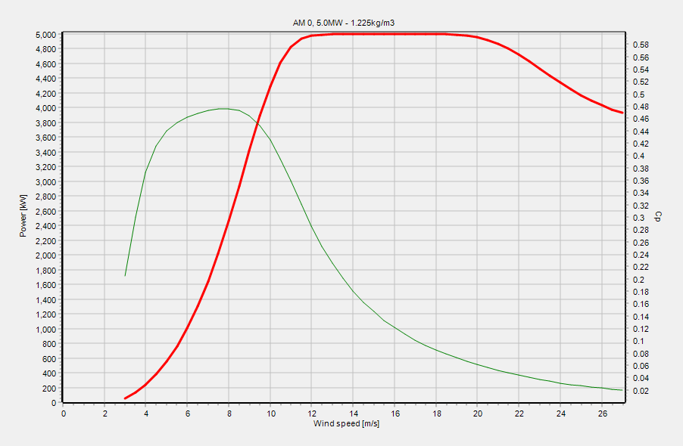
Progress: WindPro Simulation
Does the turbine have to regulate down at a certain wind speed to protect the blades and the tower?
Figure 11: Power Curve OSY160-5.0 MW
Figure 12: Power Curve of the SG5.0-145 (HH102) for Comparison [1]
Luis Urhahn
Notes:
Same Power Output…

Slide 14
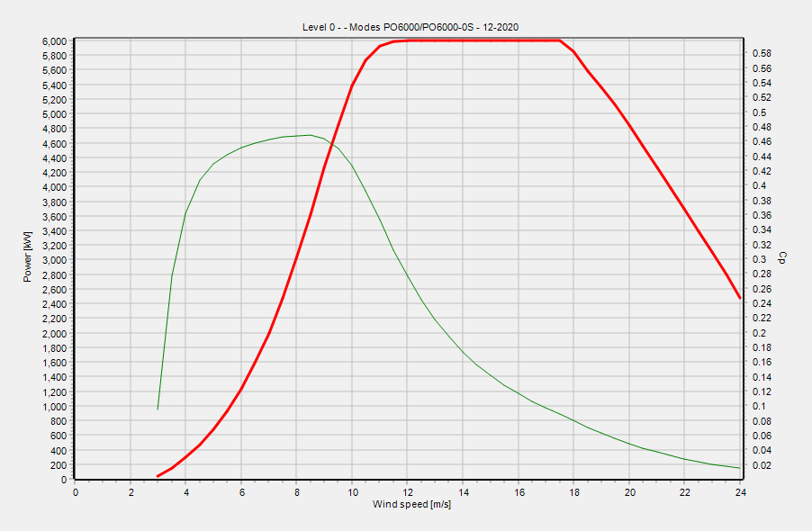
Progress: WindPro Simulation
Does the turbine have to regulate down at a certain wind speed to protect the blades and the tower?
Figure 13: Power Curve of the Vestas V162-6.0MW for Comparison [1]
Luis Urhahn
Notes:
Same Rotordiameter…

Slide 15
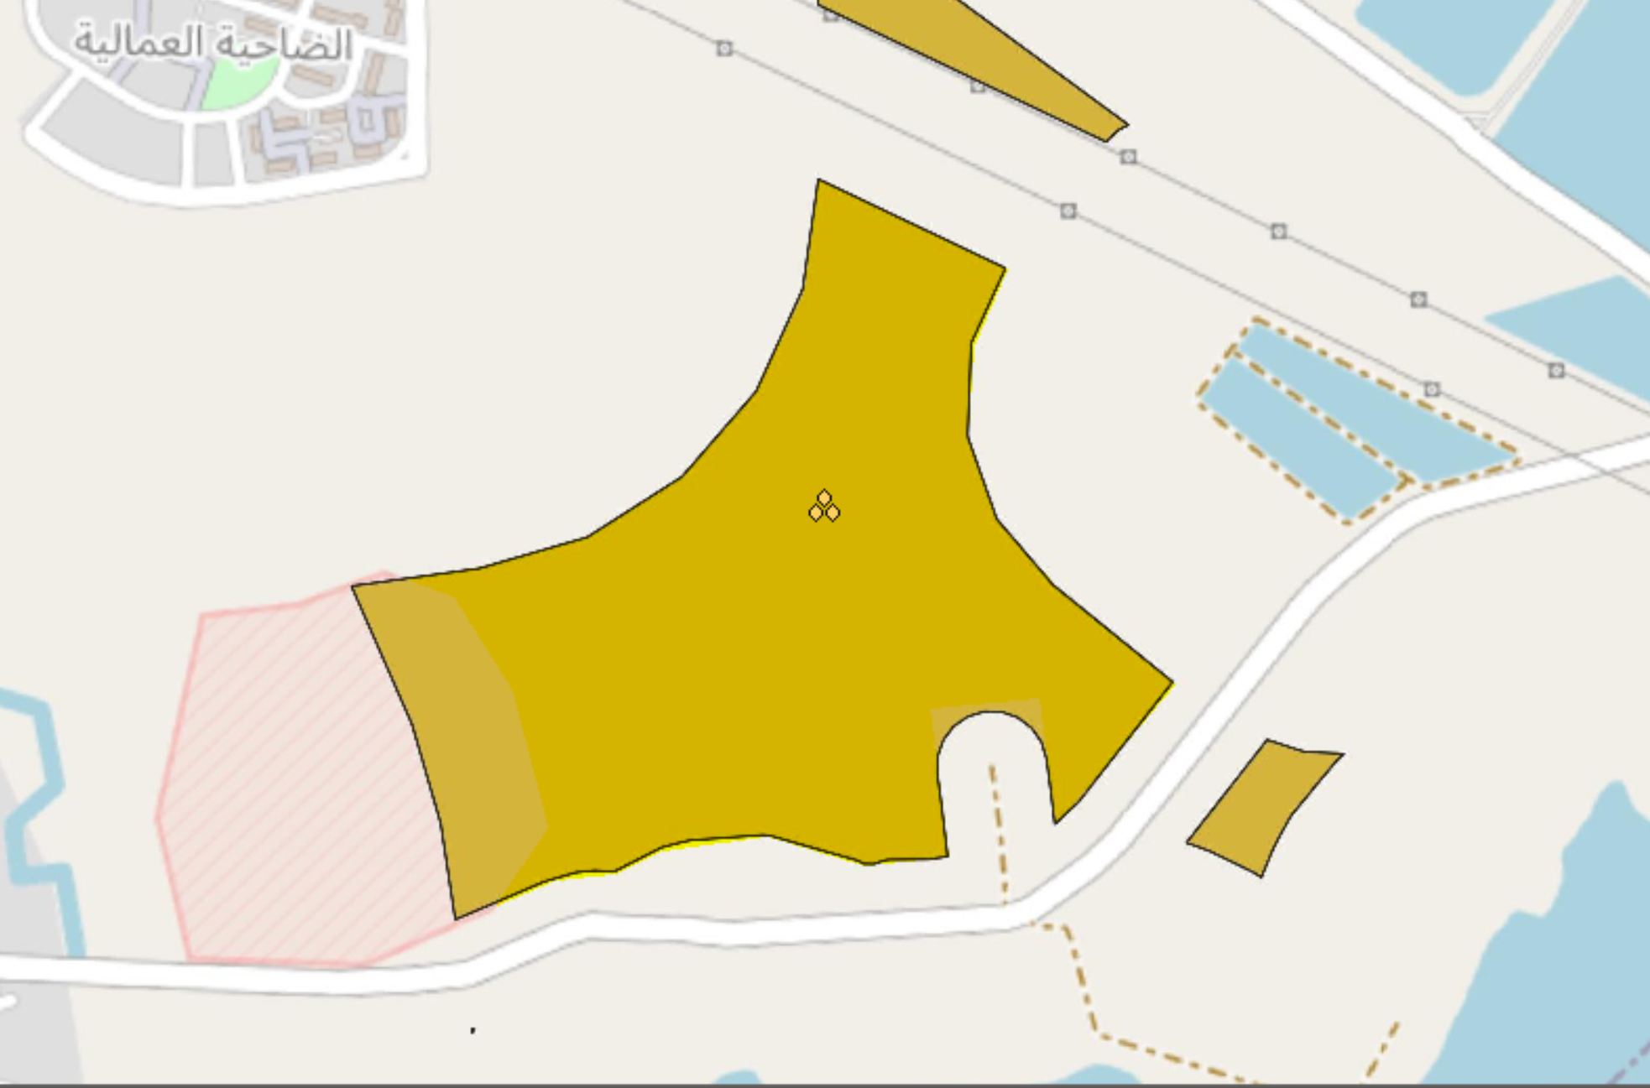
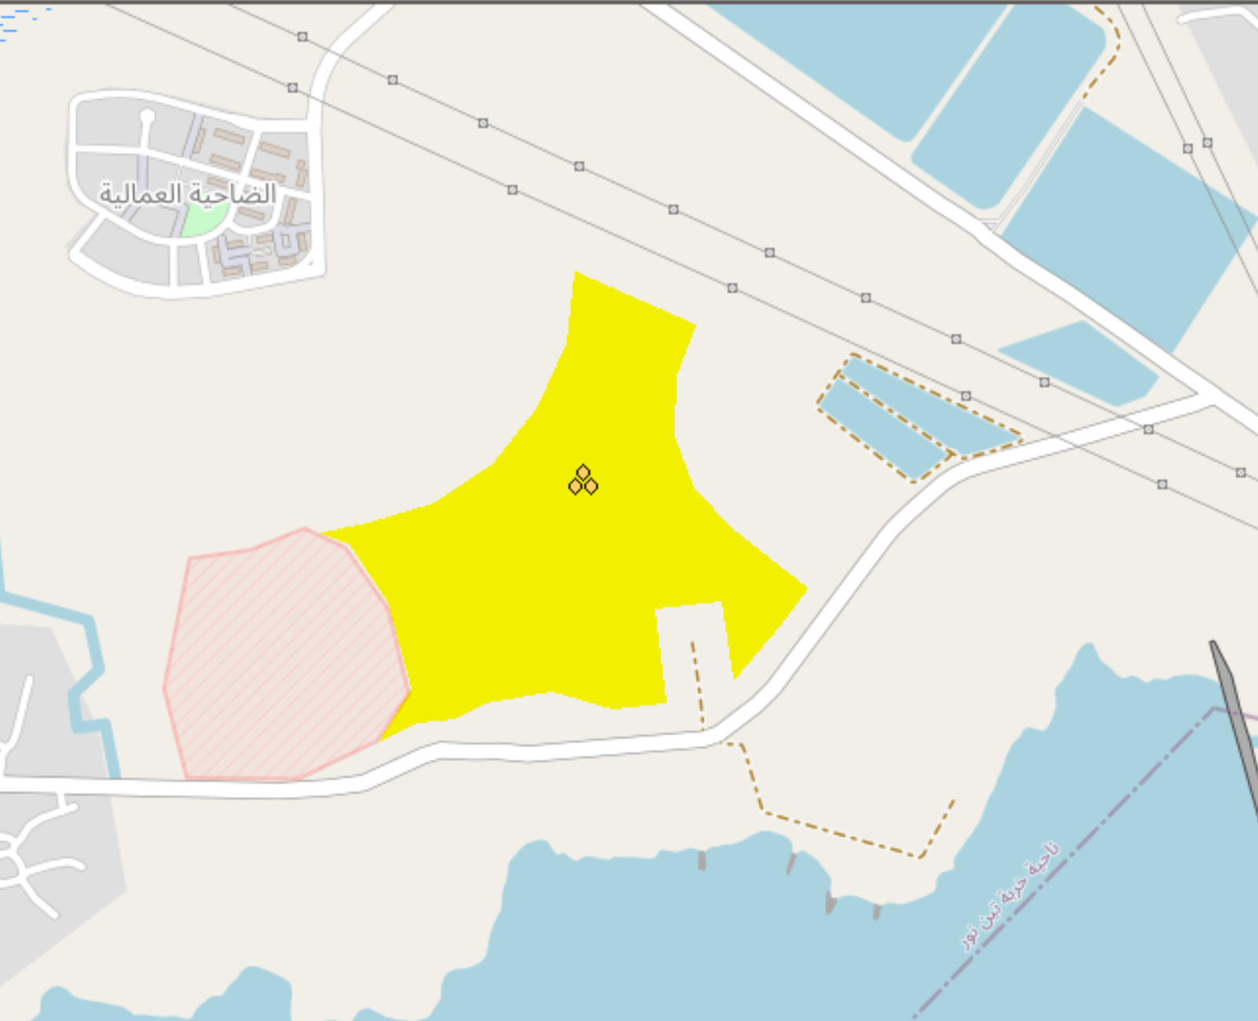
Progress: WindPro Simulation
Finalization of the Windfarm area with the help of the “white map” of QGIS
Figure 14: White Map of QGIS (considering all restrictions) [6]
Figure 15: Final WTG area in WindPro [1]
Luis Urhahn

Slide 16
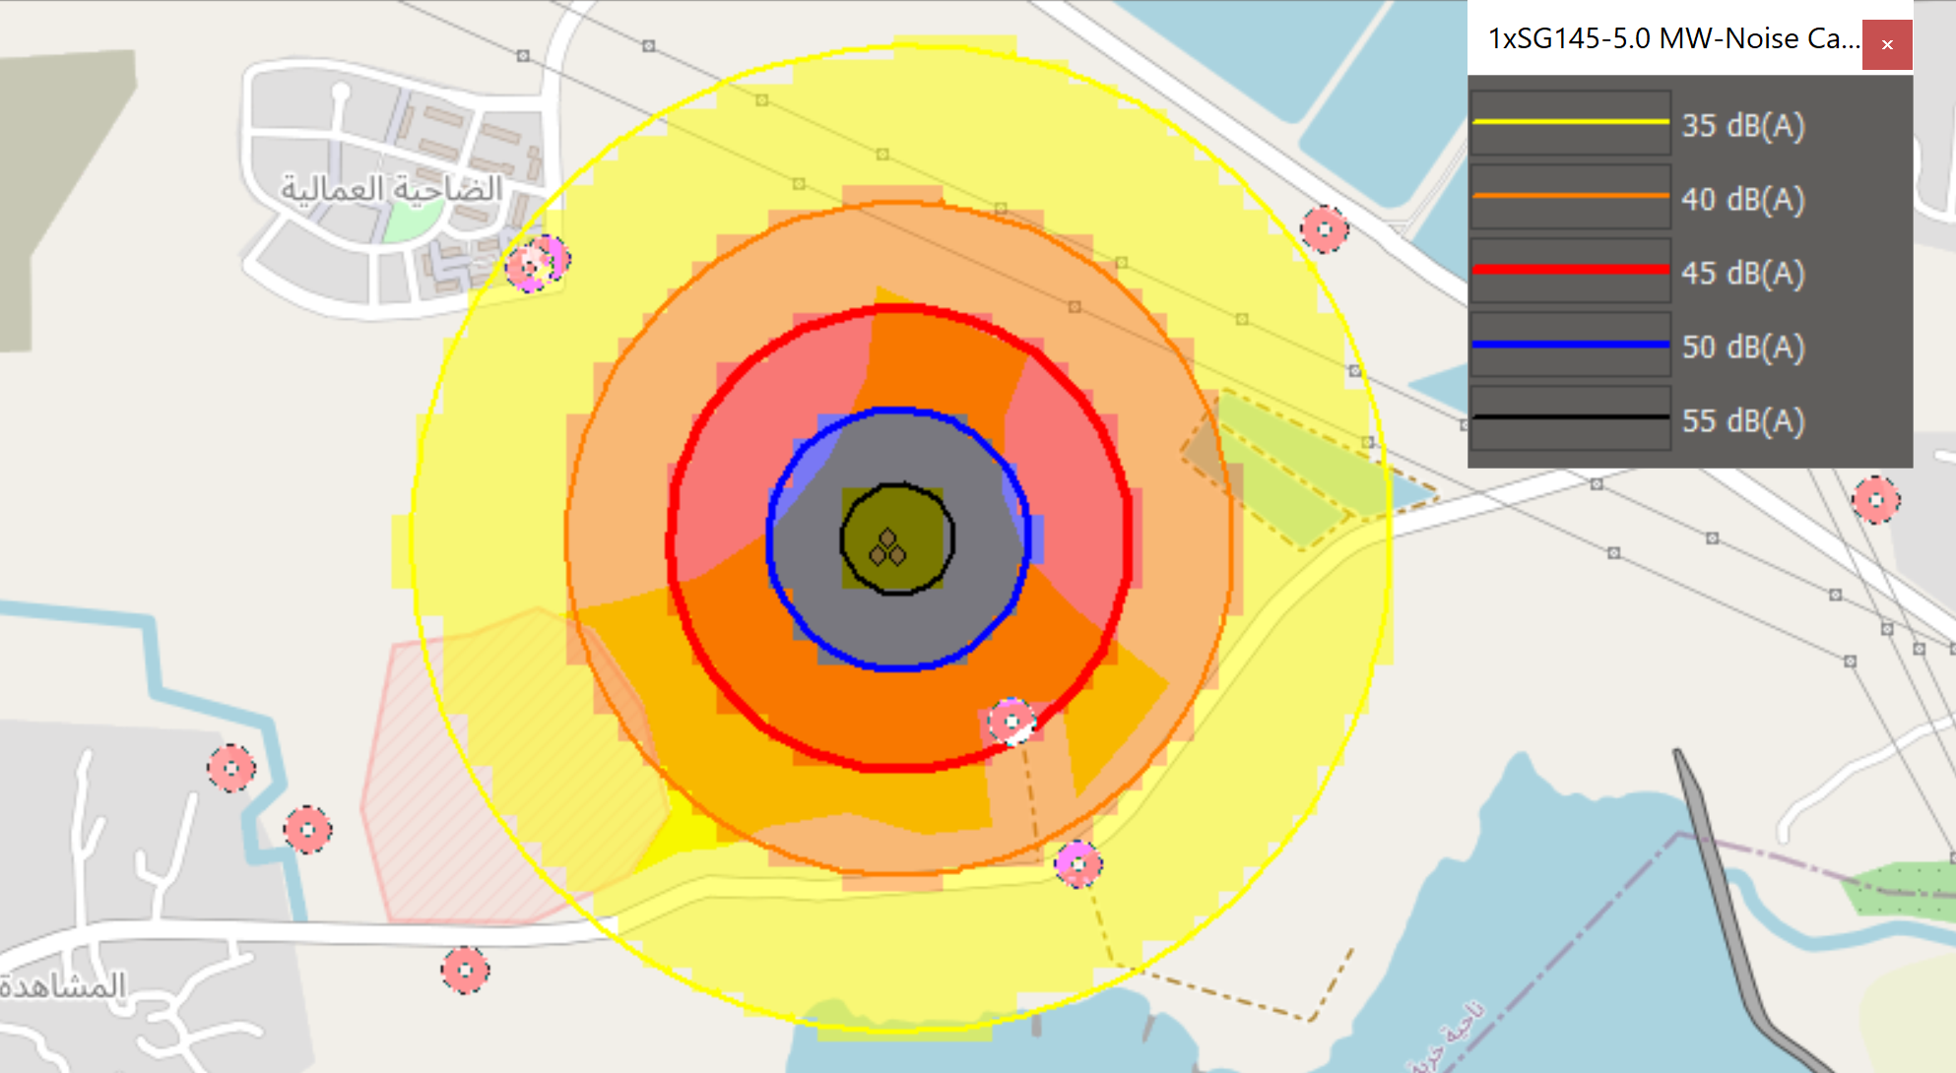
Progress: WindPro Simulation
Location | Demand [dB(A)] | Sound level [dB(A)] | Demand fulfilled?
A | 45 | 38.8 | Yes
B | 45 | 36.0 | Yes
C | 55 | 34.2 | Yes
D | 60 | 45.7 | Yes
E | 60 | 38.6 | Yes
F | 45 | 32.2 | Yes
G | 45 | 30.3 | Yes
H | 45 | 31.2 | Yes
I | 45 | 26.2 | Yes
B
C
B
C
A
A
I
G
D
G
H
E
H
F
F
Figure 15: Noise calculation of our location [1]
Remember the noise restriction: 45 dB(A) for rural villages, 60 dB(A) for industry
Luis Urhahn
Notes:
Shows hat the MCP Method is the better option!

Slide 17
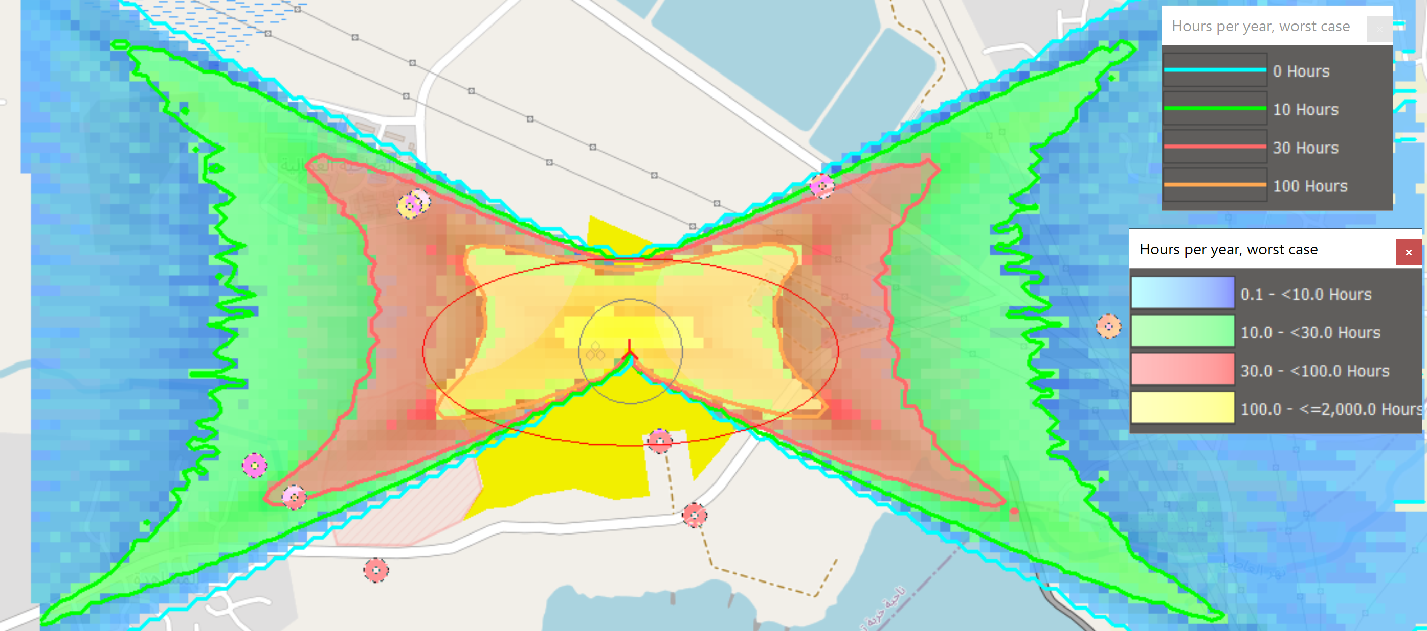
Progress: WindPro Simulation
Location | Shadow [h/year] | Shadow [h/day] | Critical?
A | 55:42 | 0:47 | Yes
B | 50:56 | 0:49 | Yes
C | 20:54 | 0:37 | Yes
D | 0:00 | 0:00 | No
E | 0:00 | 0:00 | No
F | 0:00 | 0:00 | No
G | 16:51 | 0:26 | No
H | 32:03 | 0:30 | Yes
I | 6:33 | 0:19 | No
B
C
A
I
G
D
H
E
F
Figure 16: Shadow calculation of our location [1]
Shadow restriction worst case: max. 30 h per year, max. 30 min per day
Luis Urhahn
Notes:
Shows hat the MCP Method is the better option!

Slide 18
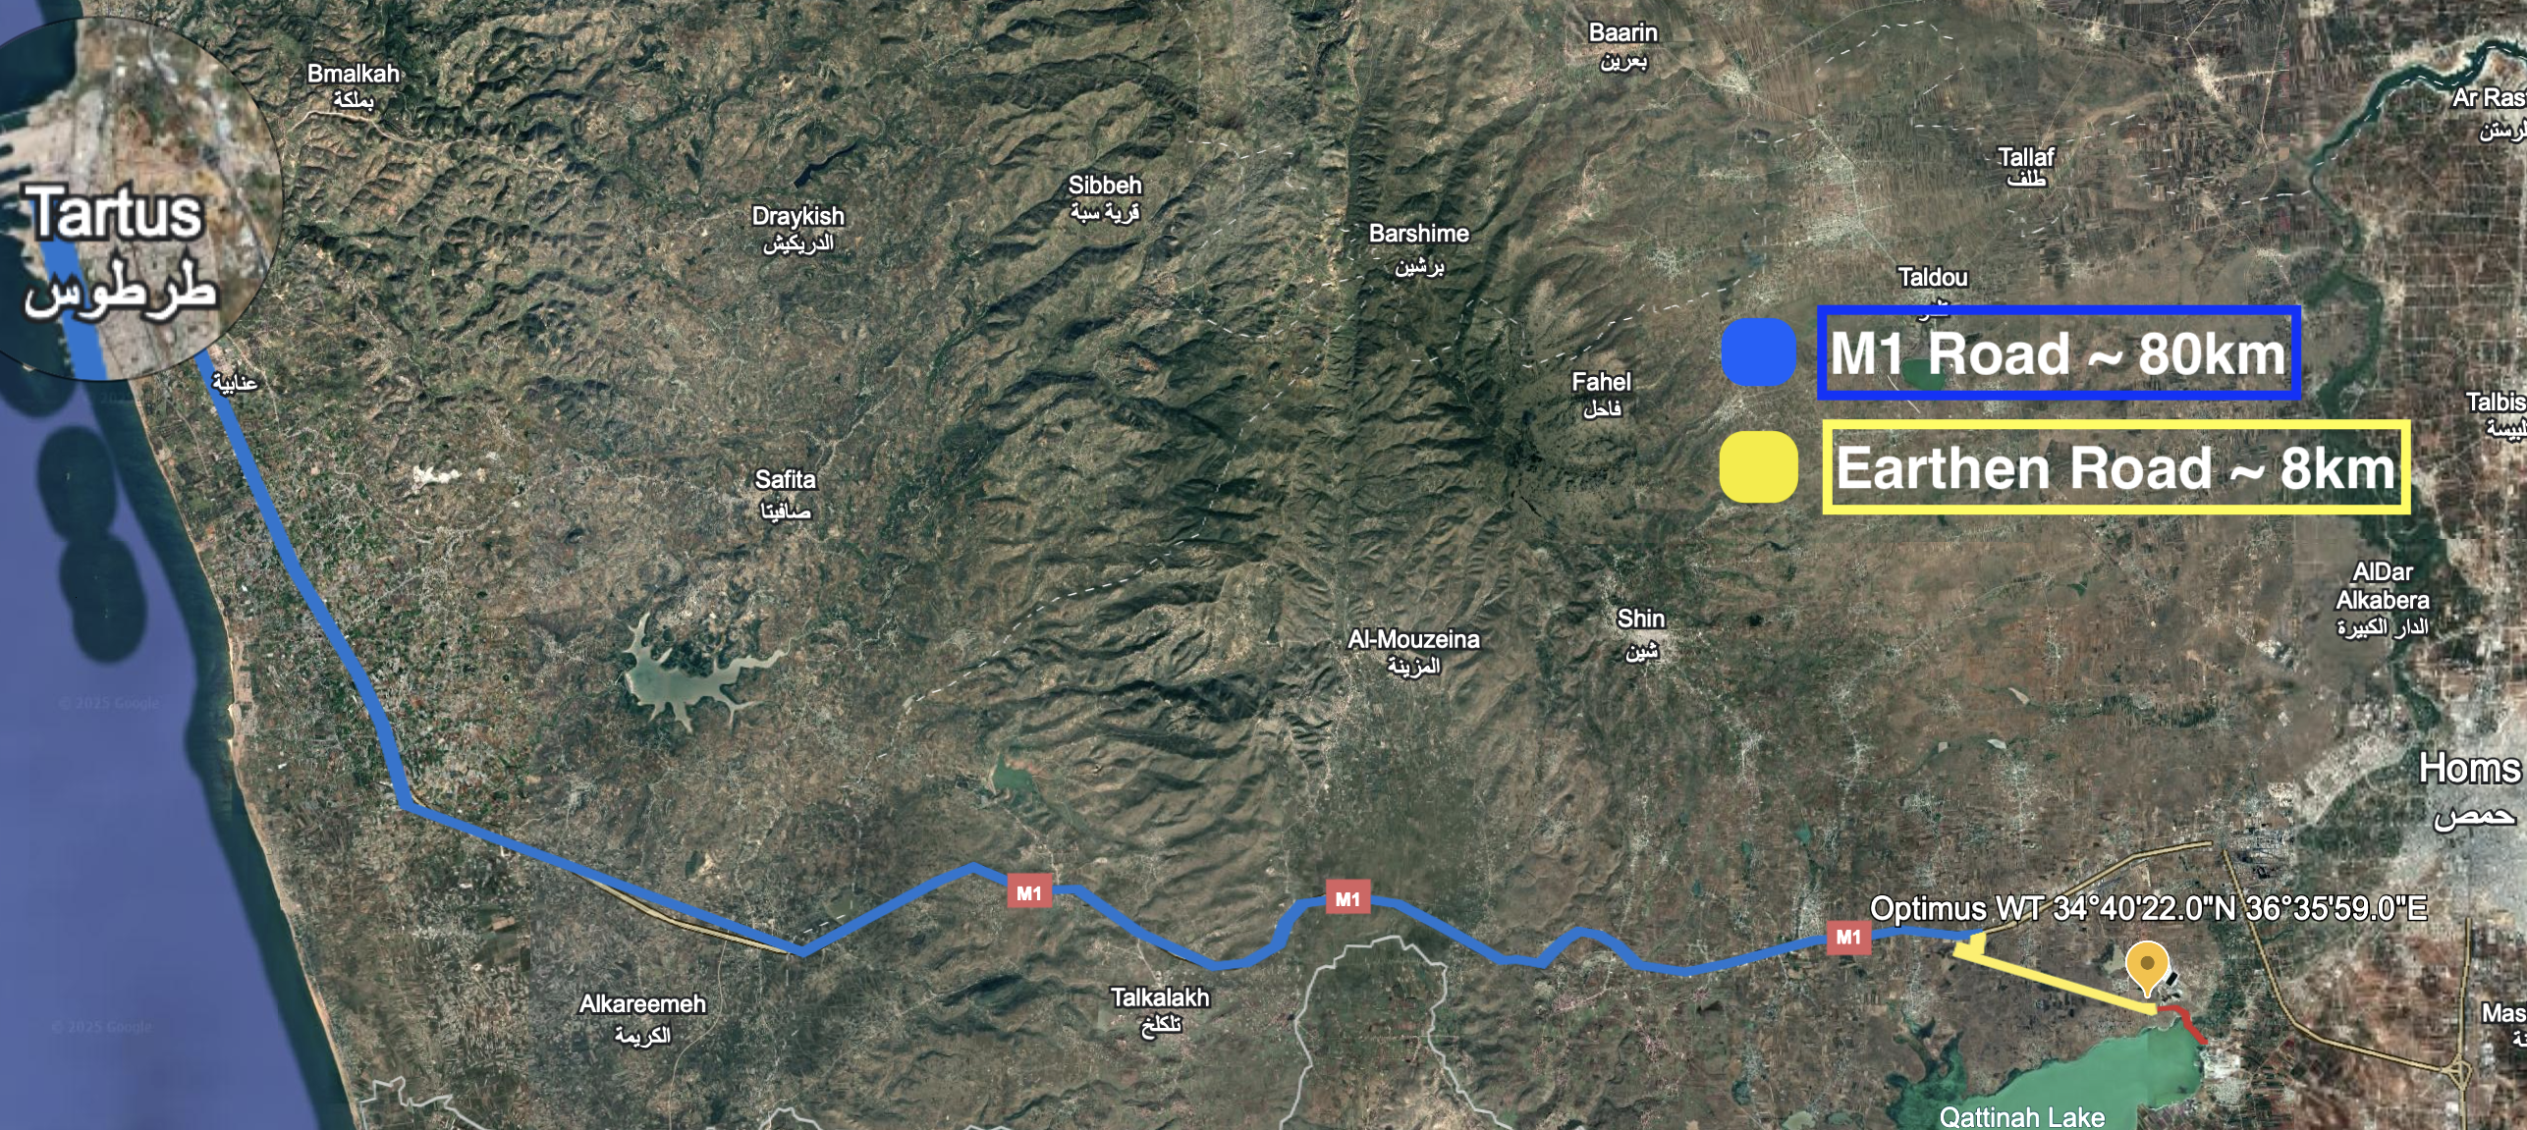
Transportation Study (Summary)
Figure 17: Screenshot main transportation route [8]
Most of the components will be shipped to the port of Tartus
Main transportation way
Two options for the final 10 km
A few challenges along the way
Luis Urhahn
Notes:
Shows hat the MCP Method is the better option!

Slide 19
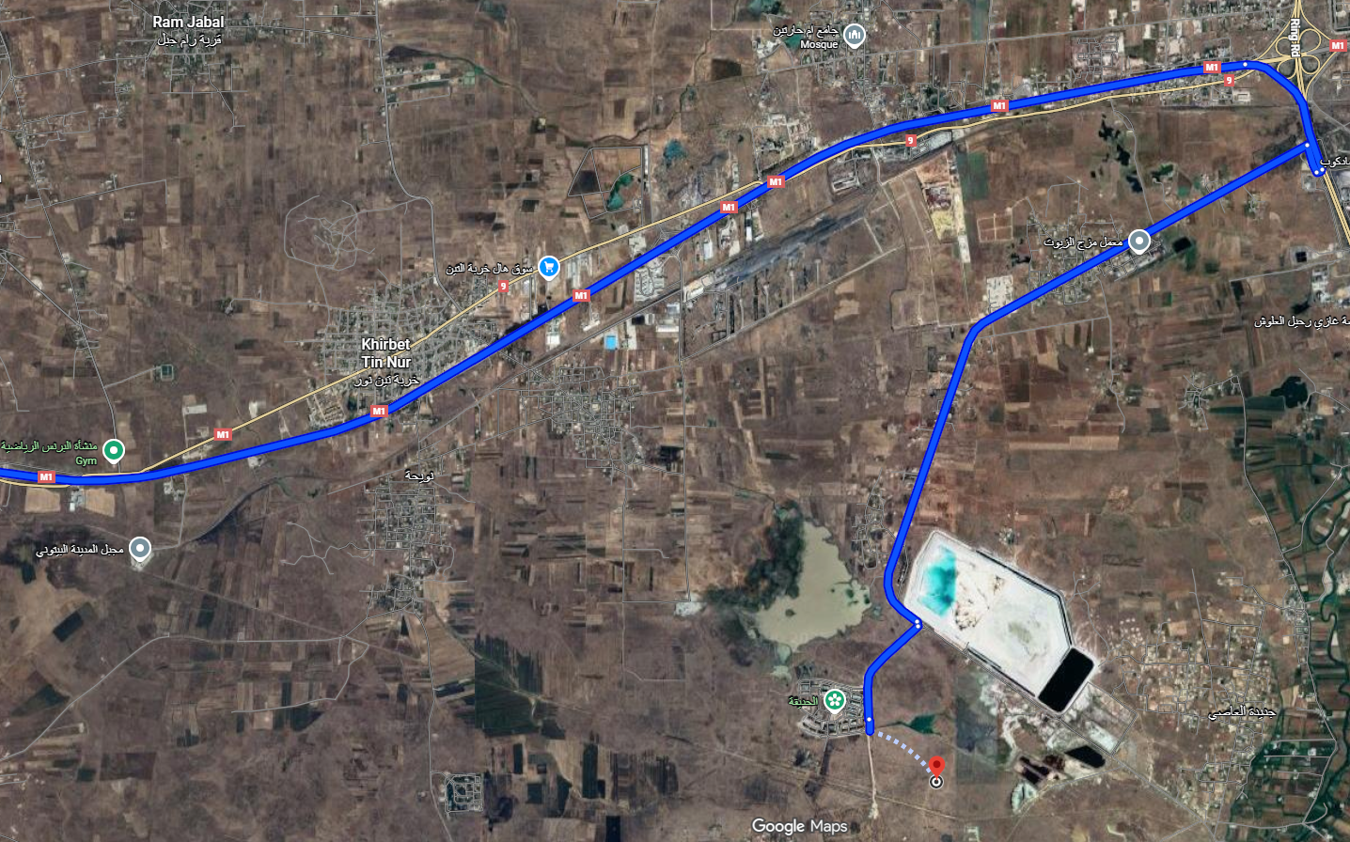
Transportation Study (Summary)
Option 2
Option 1
Figure 18: Screenshot main transportation route [8]
Option 1 (yellow): Shorter way, but build of a new road needed
Option 2 (blue): Longer way, few reinforcements still needed
Luis Urhahn
Notes:
Shows hat the MCP Method is the better option!

Slide 20
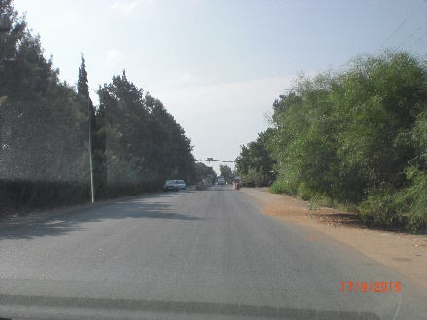
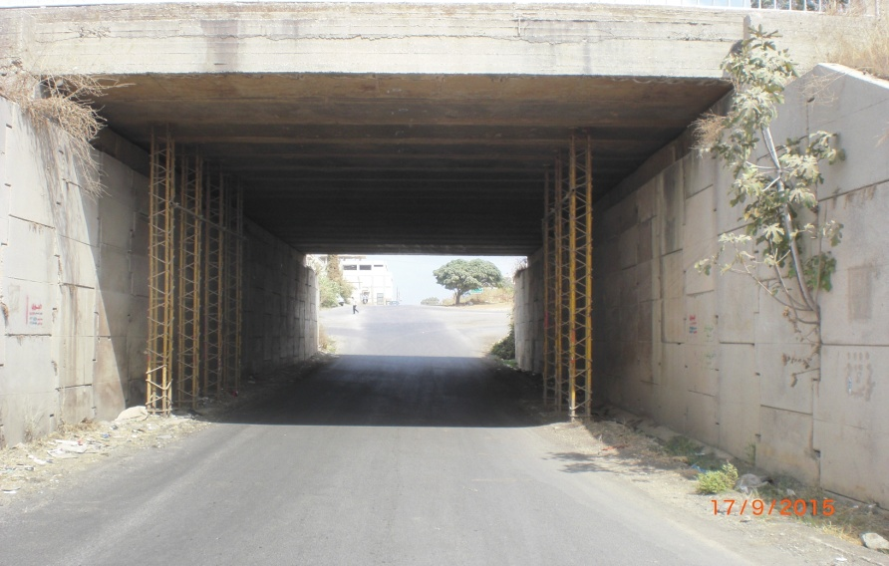
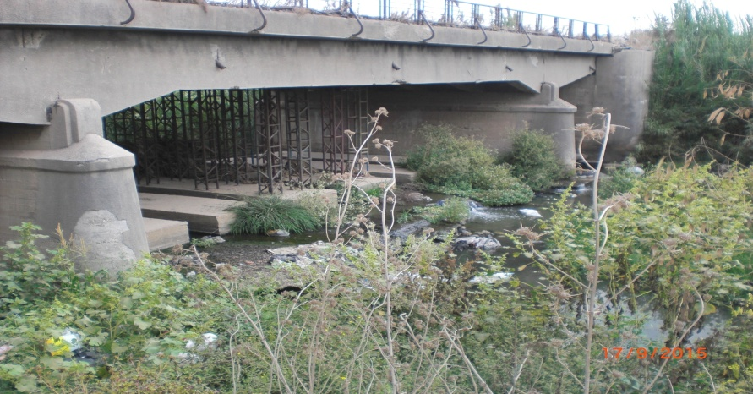
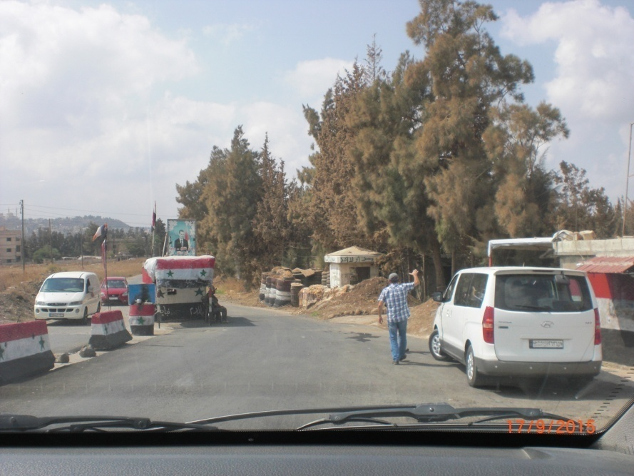
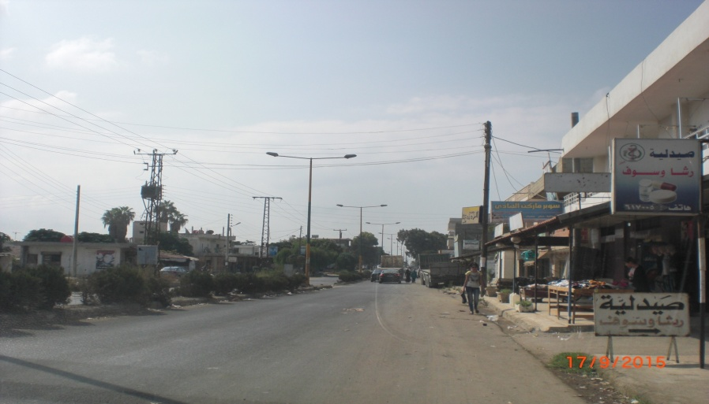
Transportation Study (Summary)
Transport challenges from the Tartus port to the final location:
Challenges/Limitations | Number
Military Checkpoints | 8
Bridge reinforcement | 7
Block/Material removal | 7
Road improvement measures | 9
Electrical wire removal | 1
Rerouting (new road) | 2
Bridge height | 4.75 m
Road width (country road, single) | 3.75 m
Road width (Highway M1, two lines) | 7.50 m
Figure 19: Pictures of road challenges [9]
Luis Urhahn
Notes:
Shows hat the MCP Method is the better option!

Slide 21
Research Earthquake Situation
Guideline or Recommended Practise: “DNV-RP-0585: Seismic design of wind power plants” [3]
Not focusing on the Richter scale
Analysis will be based on the Probabilistic Seismic Hazard Analysis (PSHA)
Needs the input of the Peak Ground Acceleration (PGA)
Extreme scenario needs to withstand the max earthquake for 475 years
Return period of the max earthquake
Defined as the standard Ultimate Limit State (ULS)
For our analysis: Response Spectrum Analysis (RSA)
A simplified, widely used method, based on PGA
The PGA for the Homs District is 0.38 to 0.40 g. [4], [5]
Luis Urhahn

Slide 22
Clarification of the cost analysis
We will summarise the total cost of the turbine
We will calculate the transportation cost to our location
We will calculate the LCOE of the single turbine and a possible windfarm
But therefore…
You need to give us the total cost (final) of your components AND
You need to tell us where you will produce or buy the component!
→ If you need any help or guidance for the cost analysis, please let us know!
Our task
Your task
Luis Urhahn

Slide 23
Next Steps
The next steps for our Team:
Transportation cost analysis
Meeting with experts regarding the permitting process in Syria
Development of a possible windfarm at our location
Cable routing to the substation
Progressing the detailed LCOE calculation
Luis Urhahn
Notes:
Shows hat the MCP Method is the better option!

Slide 24
Bibliography – Project Development
[1] WindPro, University License for WindPro [Software] (latest on 09.11.25)
[2] Google Gemini, Student License for Gemini [AI] (latest on 08.11.25)
[3] DNV, DNV-RP-0585 Seismic design of wind power plants, (latest 12.11.25)
[4] ResearchGate, Seismic Hazard Assessment of Syria, https://www.researchgate.net/profile/Raed-Ahmad-2/publication/286870802_Seismic_Hazard_Assessment_of_Syria/links/566ead0308ae430ab5003171/Seismic-Hazard-Assessment-of-Syria.pdf , (latest 12.11.25)
[5] Scientific Research, Re-Evaluation of Seismic Hazard of Syria https://www.scirp.org/pdf/ijg20120400008_81946431.pdf , (latest 12.11.25)
[6] QGIS, Public Software of QGIS [Software]
[7] Lecture notes of “Project Development“ and “Advanced Windfarm Planning“
[8] Google, Google Maps. [Online]. Available: https://maps.google.com
[9] Pictures of Road Condition Port Tartus to Homs, Document Uni Damaskus
→ Simulation developed with the help of AI.
Luis Urhahn

